Slide 1




Internship Program
Data Analytics using Power BI
An Approved Internship Program under the VTU - iRobo Automation MoU
Ms. Chandana C
Intern , iRobo Automation Pvt Ltd

Slide 2
Internship Program
Data Analytics using Power BI
Detailed Study of Power BI Visual : Funnel Chart and Scatter Chart
Data Visuals in Power BI
Visual representation of data using charts, graphs, and dashboards
Converts raw data into meaningful insights
Makes data easy to understand for all users
Helps identify trends, patterns, and relationships
Supports quick and effective decision-making

Slide 3
Internship Program
Data Analytics using Power BI
Detailed Study of Power BI Visual : Funnel Chart and Scatter Chart
FUNNEL CHART
What is funnel chart?
A Funnel Chart is a visualization used to track the data/Performance through different stages.
The top stage represents the highest value, and each next stage shows a reduction.
Why Do We Use Funnel Charts?
Used to analyze step-by-step processes where data flows in sequence.
Help identify where drop-offs occur in the process.
Shows the weakest stage that needs improvement.
Measures process efficiency from start to end.

Slide 4
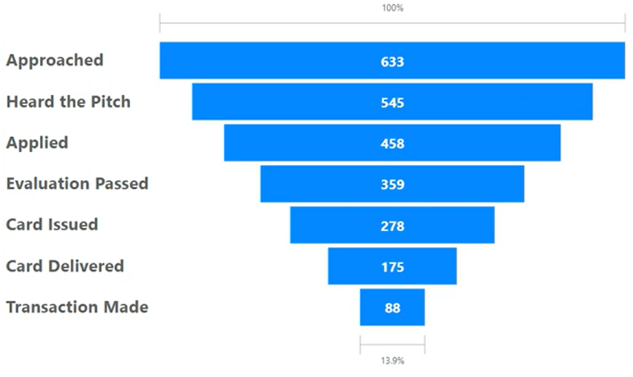
Internship Program
Data Analytics using Power BI
Detailed Study of Power BI Visual : Funnel Chart and Scatter Chart
For example,
In a credit card company a successful sell of credit card can be analysed using funnel chart as given here.

Slide 5
Internship Program
Data Analytics using Power BI
Detailed Study of Power BI Visual : Funnel Chart and Scatter Chart
Key Features of Funnel Chart
Stage-wise Representation - Shows each step of the process clearly.
Automatic Sorting - Displays data in descending order with highest at top.
Data Labels - Shows values and percentages for easy understanding.
Visual Drop-off - Clearly highlights where the biggest decrease occurs.

Slide 6
Internship Program
Data Analytics using Power BI
Detailed Study of Power BI Visual : Funnel Chart and Scatter Chart
Applications of Funnel Chart
In sales → tracking customer journey
In e-commerce → tracking purchases
In recruitment → tracking hiring stages
In manufacturing → tracking production flow
Advantages of Funnel Chart
Easy to Understand – Simple visual makes process flow clear
Shows Drop-offs Clearly – Identifies where major losses occur
Supports Decision-Making – Helps improve weak stages
Saves Time – Provides quick insights at a glance

Slide 7
Internship Program
Data Analytics using Power BI
Detailed Study of Power BI Visual : Funnel Chart and Scatter Chart
SCATTER CHART
What is a Scatter Chart?
A Scatter Chart (Scatter Plot) is a visualization used to show the relationship between two numerical variables by plotting data points on a 2D plane.
Each data point represents one observation.
It is plotted using:
X-axis - The variable that influences or affects another
Y-axis - The variable that depends on X
A scatter chart shows how one variable affects another.

Slide 8
Internship Program
Data Analytics using Power BI
Detailed Study of Power BI Visual : Funnel Chart and Scatter Chart
Key Features of scatter chart
Two-axis representation – Uses X-axis and Y-axis to plot data
Data points (markers) - Each point represents a single record
Bubble size- Larger bubbles indicate higher values of that variable
Legend (Color Coding) - Categories shown using different colors
Play axis for animations - Shows changes over time dynamically

Slide 9
Internship Program
Data Analytics using Power BI
Detailed Study of Power BI Visual : Funnel Chart and Scatter Chart
Why Use Scatter Chart?
To understand relationship between variables
To identify correlation
Positive/Direct Correlation- As X increases if Y increases
Negative/Inverse Correlation- As X increases if Y decreases
No Correlation – if there is no clear pattern
To detect patterns and trends
To find outliers (abnormal values)

Slide 10
Internship Program
Data Analytics using Power BI
Detailed Study of Power BI Visual : Funnel Chart and Scatter Chart
Applications
Business: To analyze relationships like sales vs profit to understand performance
Marketing: Helps compare advertising spend with revenue or customer reach.
Manufacturing: Used to study machine efficiency by comparing inputs and outputs.
Supply Chain: Analyzes delivery time versus cost or efficiency.
Education: To compare study hours with marks or performance
Advantages
Shows relationships clearly - Helps identify trends between variables
Identifies patterns and trends - Detect clusters, gaps, and trends
Detects outliers - Easily spots abnormal values (Points far from others)
Supports multiple variables - Can include size and color for extra insights

Slide 11
Internship Program
Data Analytics using Power BI
Detailed Study of Power BI Visual : Funnel Chart and Scatter Chart
THANK YOU

